Slide 1
Deep Learning Specialization- cousera

Slide 2
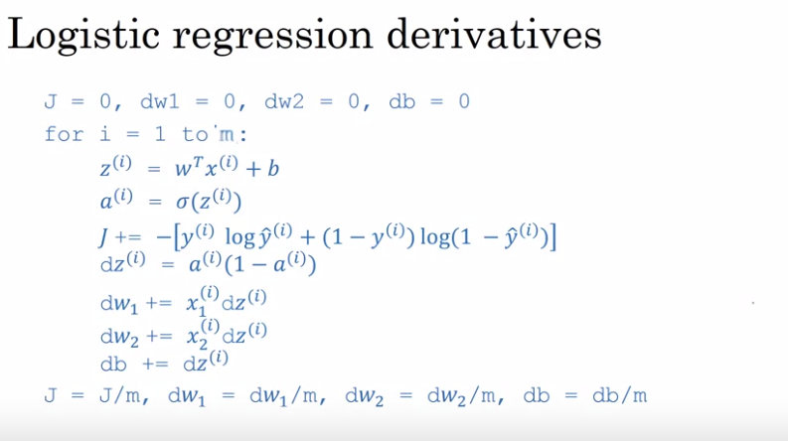

Slide 3
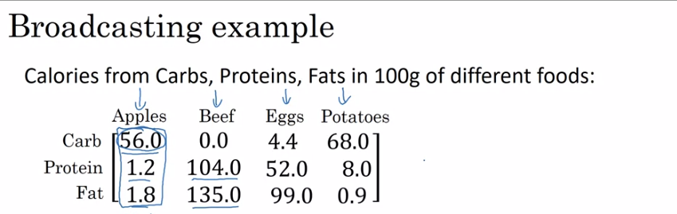
A matrix (3,4)

Slide 4
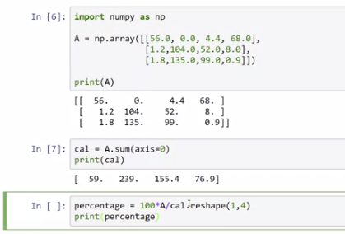

Slide 5
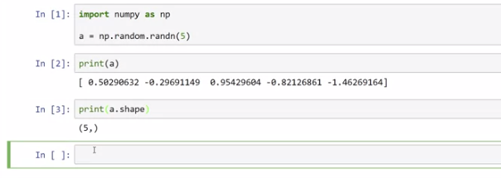

Slide 6
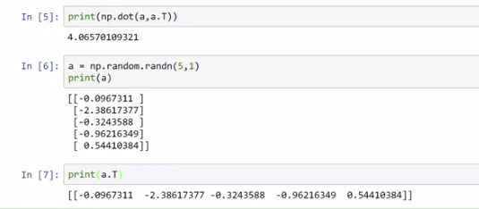

Slide 7
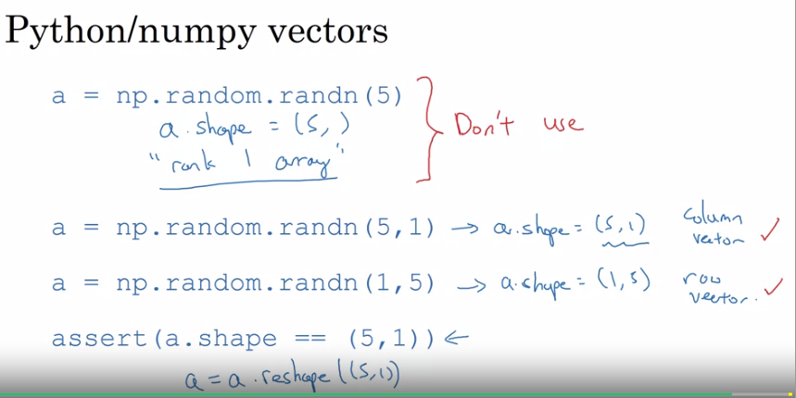

Slide 8
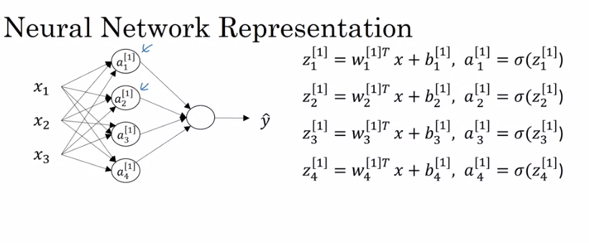

Slide 9
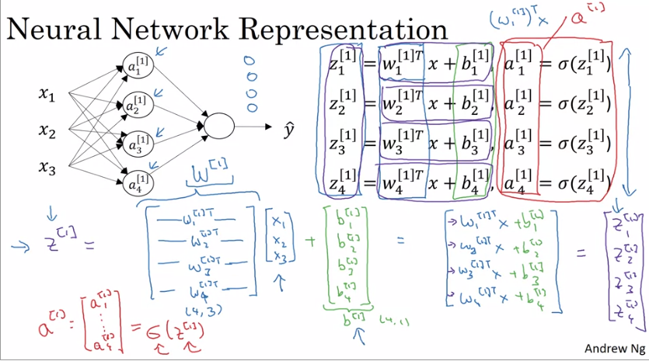

Slide 10
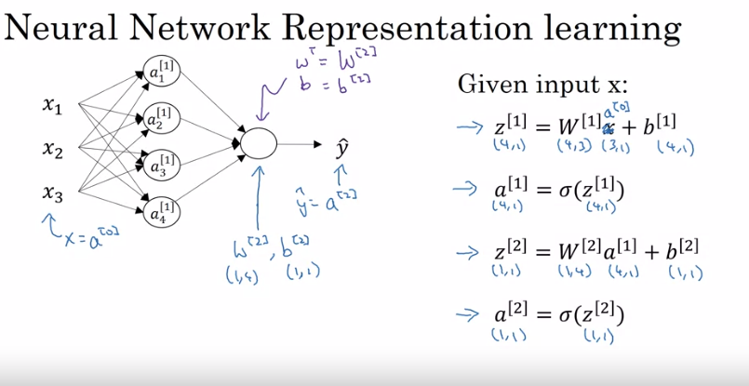

Slide 11
Common steps for pre-processing a new dataset are:
Figure out the dimensions and shapes of the problem (m_train, m_test, num_px, ...)
Reshape the datasets such that each example is now a vector of size (num_px * num_px * 3, 1)
"Standardize" the data

Slide 12
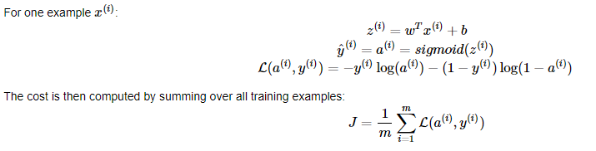
Building a Logistic Regression, using a Neural Network mindset

Slide 13
Building the parts of our algorithm
The main steps for building a Neural Network are:
Define the model structure (such as number of input features)
Initialize the model's parameters
Loop:
Calculate current loss (forward propagation)
Calculate current gradient (backward propagation)
Update parameters (gradient descent)

Slide 14
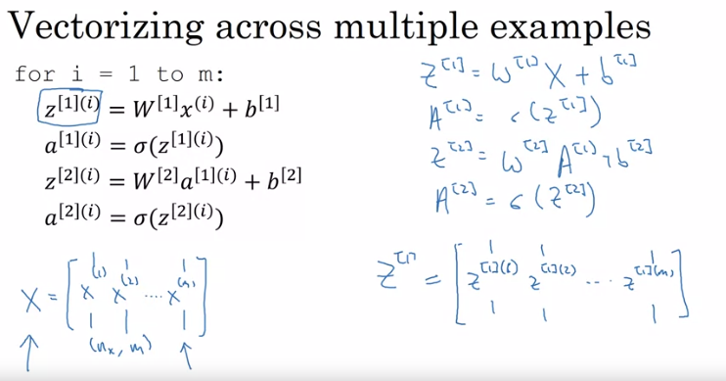
Vectorizing across multiple examples

Slide 15
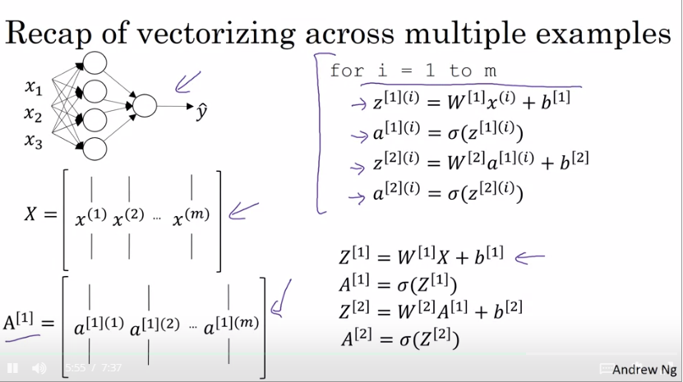

Slide 16
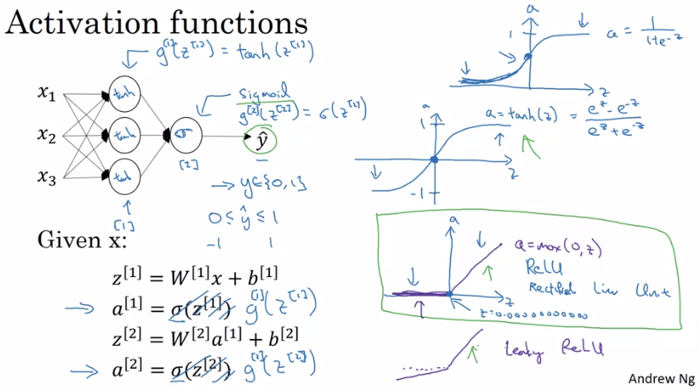

Slide 17
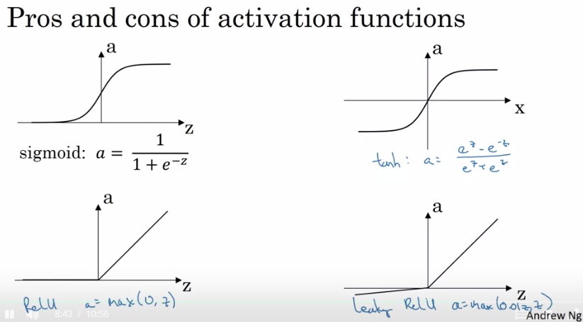

Slide 18
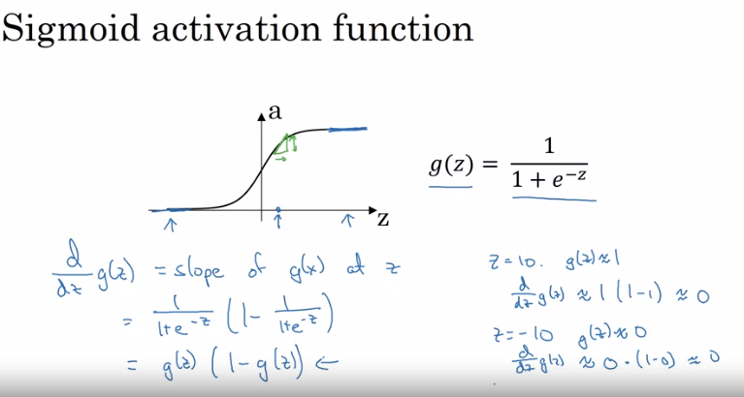
Derivatives of activation functions

Slide 19
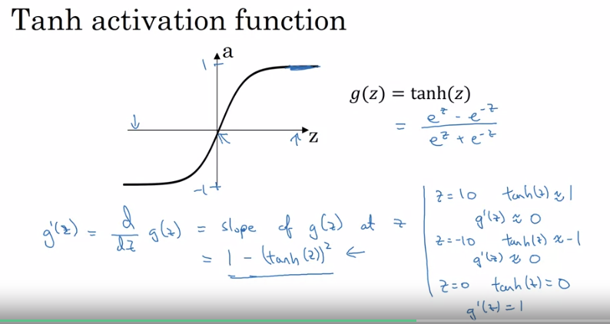

Slide 20
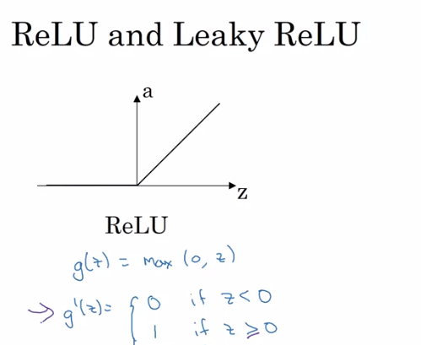

Slide 21
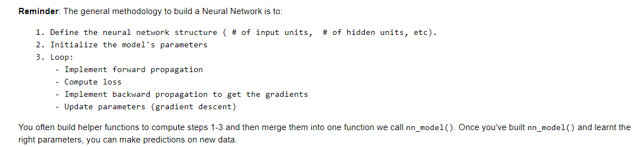

Slide 22
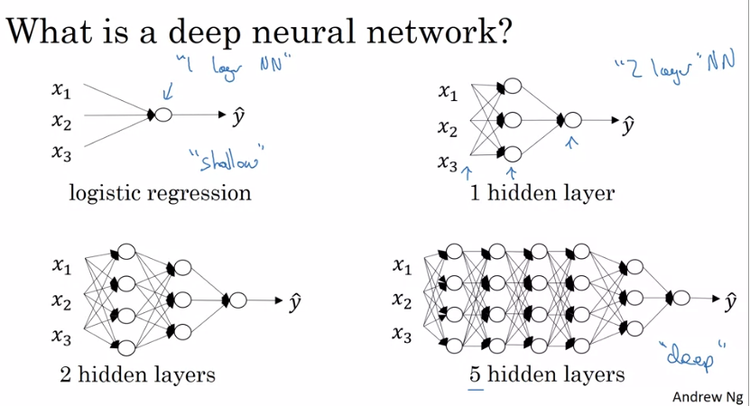

Slide 23
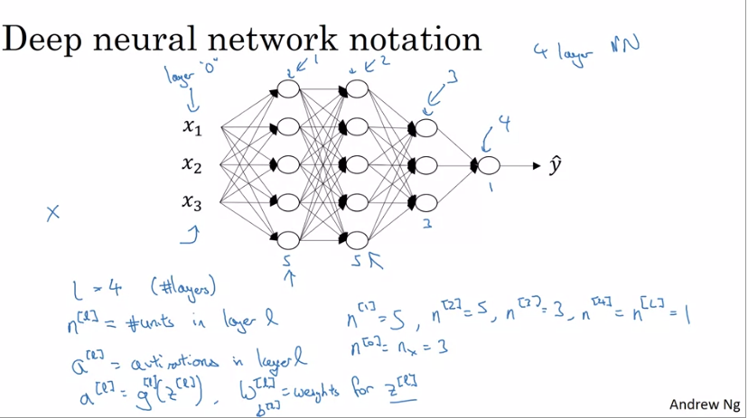

Slide 24
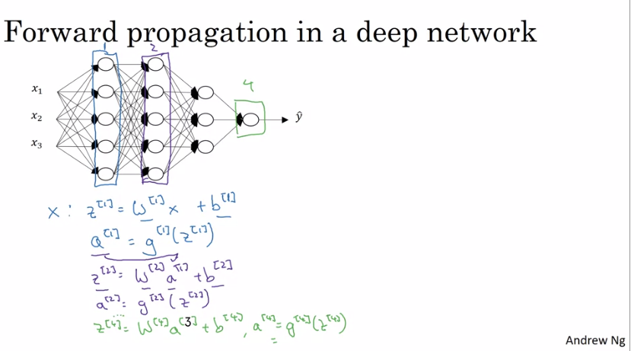

Slide 25
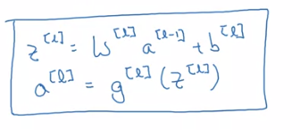
Forward Propagation Equation

Slide 26
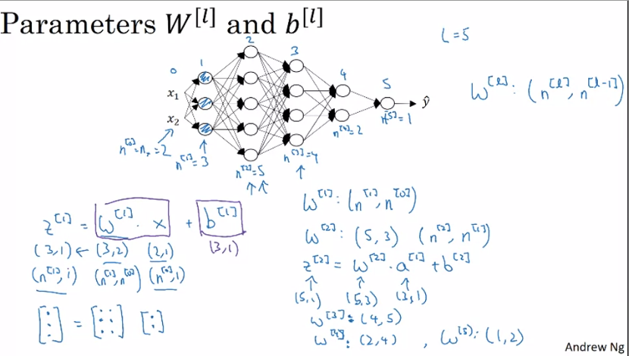

Slide 27
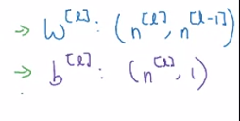
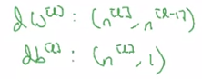
Dimension of w and b

Slide 28
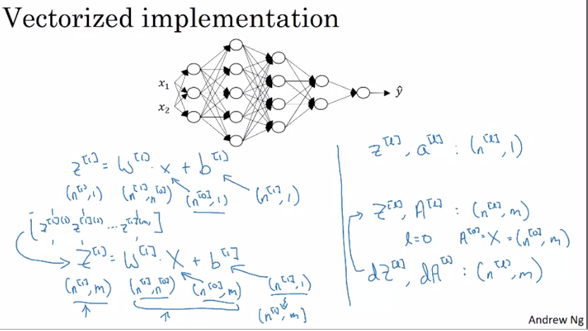

Slide 29
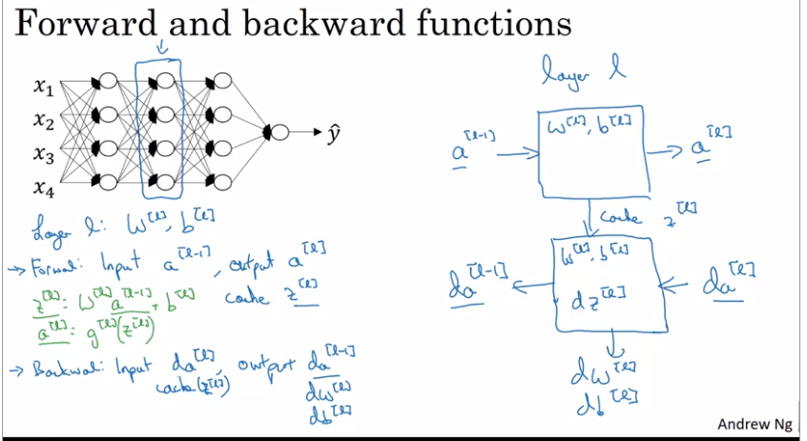

Slide 30
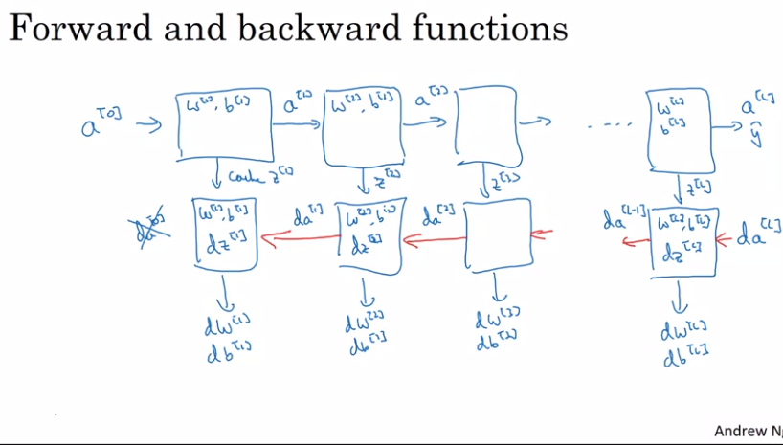

Slide 31
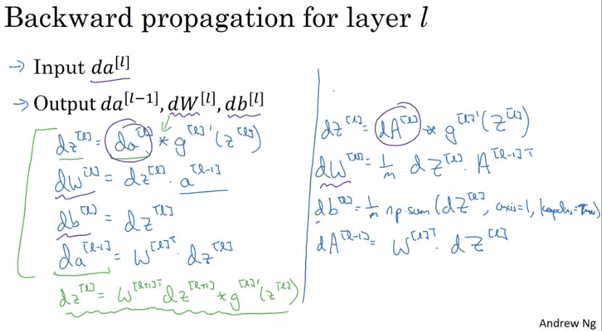

Slide 32
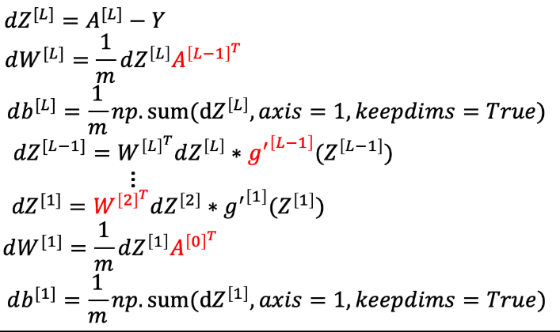
Formulas

Slide 33
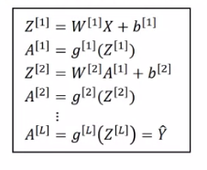
Formulas

Slide 34
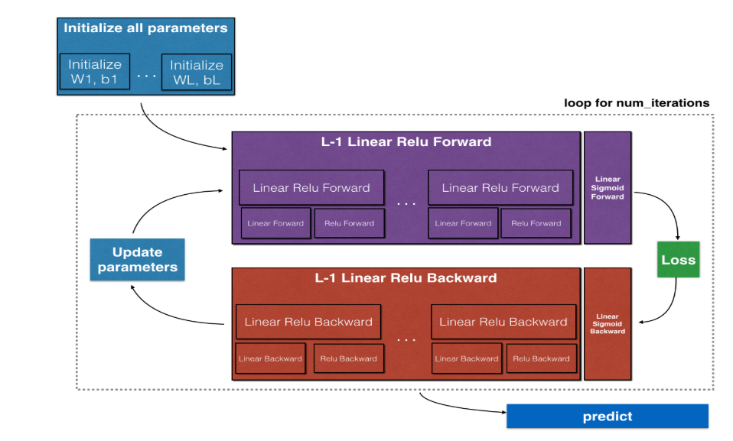

Slide 35
